Slide 1

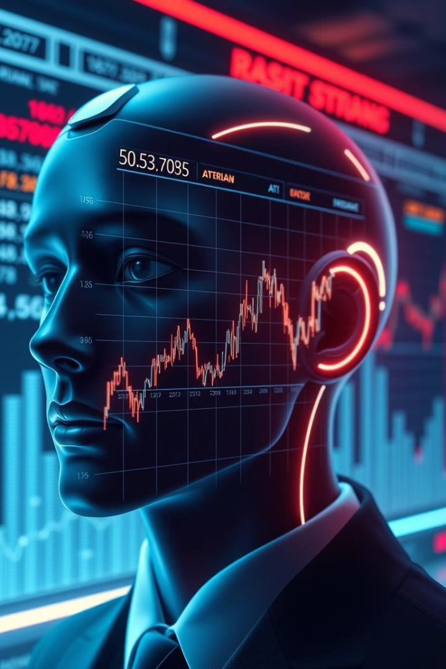
Stock Market Prediction AI System
Revolutionizing investment strategies using cutting-edge artificial intelligence.
Our system, developed with Python and Tkinter, offers an enhanced and intuitive user experience.
TEAM :-
Yash Chauhan – RA2311003011362
Aaditya Gupta – RA2311003011388
Ishan Rajora – RA2311003011404
Notes:
1

Slide 2
Introduction: AI in Stock Market Prediction
The Growing Need
Transforming Investment
Accurate stock predictions are increasingly vital in today's fast-paced market.
AI and machine learning are revolutionizing how investments are strategized and executed.
Our innovative AI system provides insightful analysis and reliable forecasts, empowering investors to make informed decisions.
Notes:
2

Slide 3
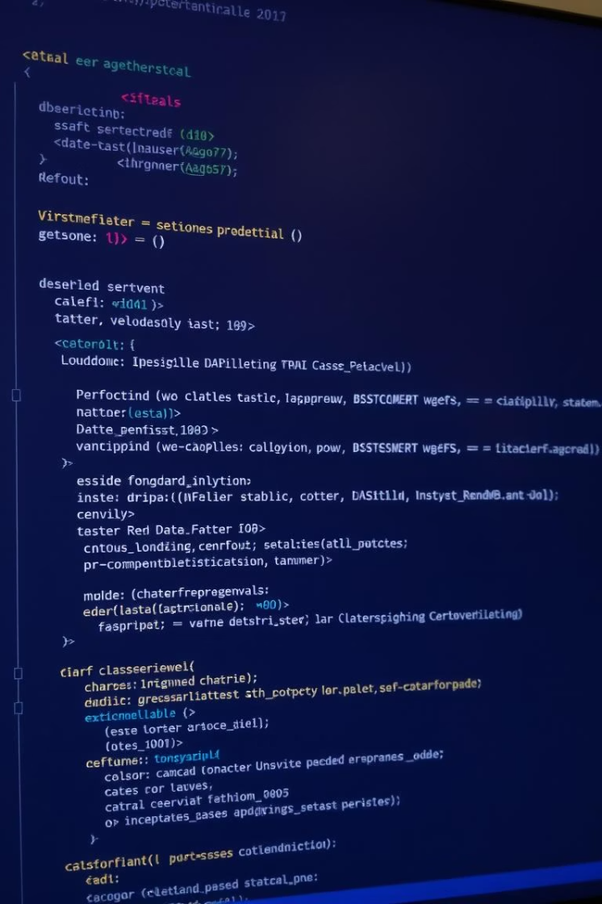



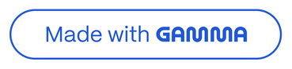
System Overview: Python & Tkinter GUI
Built on Python
Tkinter GUI
Robustness and flexibility for reliable performance.
A user-friendly interface for seamless navigation.
Modular Design
Ensuring scalability and future enhancements.
Our system is engineered for efficiency and ease of use, making advanced technology accessible to all investors.
Notes:
3

Slide 4
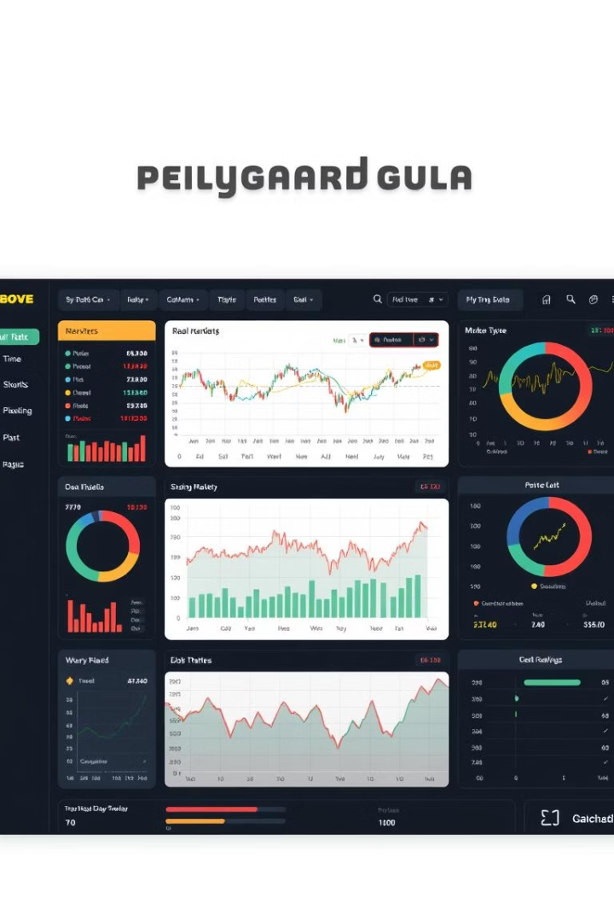




Core User Functionalities
Secure Login
Predict Stock
Recommend Stocks
View History
From secure access to insightful recommendations, our system equips you with the tools for successful investing.
Notes:
4

Slide 5



Machine Learning Integration
Advanced Algorithms
1
Forecasting stock prices.
2
Historical Data
Models are continuously trained.
3
Continuous Learning
Refining model accuracy.
Our system leverages advanced machine learning models, trained on extensive historical data, to deliver precise stock price forecasts.
Notes:
5

Slide 6
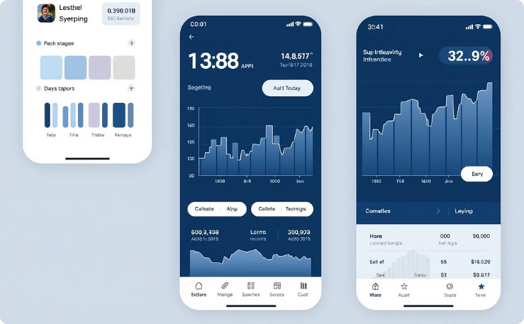
Visual Design: Custom Color Schemes
Appealing Design
Enhancing user experience.
Our custom color schemes and intuitive layout offer a visually appealing and user-friendly experience.
We adhere to modern UI/UX principles, ensuring seamless navigation.
Notes:
6

Slide 7



Responsive UI with Modern Tkinter
Responsive Design
Adapts to different screens.
Smooth Animations
Fluid transitions.
Modern Widgets
Enhanced Interaction.
Our responsive Tkinter design adapts flawlessly to various screen sizes, providing smooth animations and modern widgets for a truly interactive experience.
Notes:
7

Slide 8
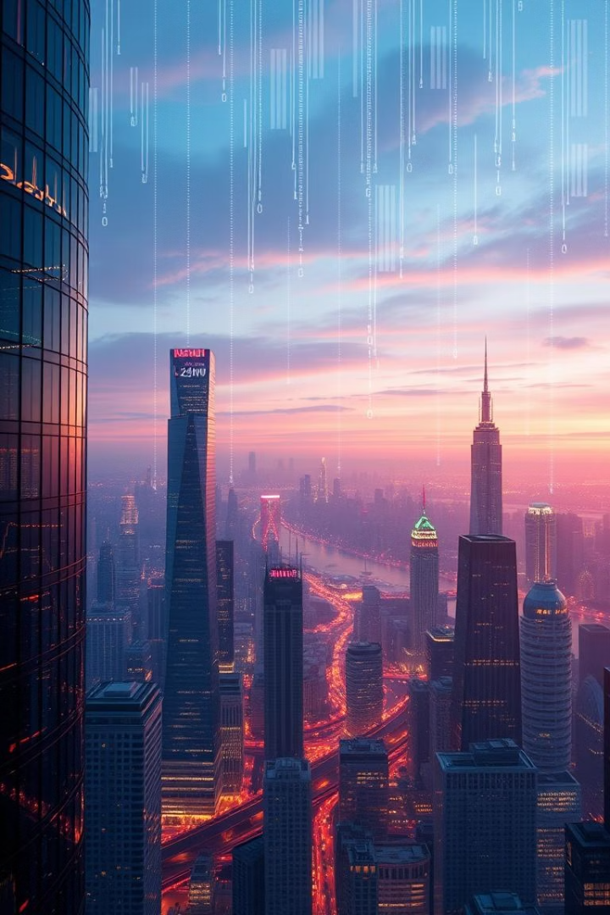



Conclusion: The Future of AI in Investing
Empowering Investors
AI-driven insights.
Continuous Innovation
Ongoing development.
Transforming Market
Stock market prediction.
We empower investors with AI-driven insights, constantly innovating and transforming the landscape of stock market prediction.
Notes:
8

